Slide 1
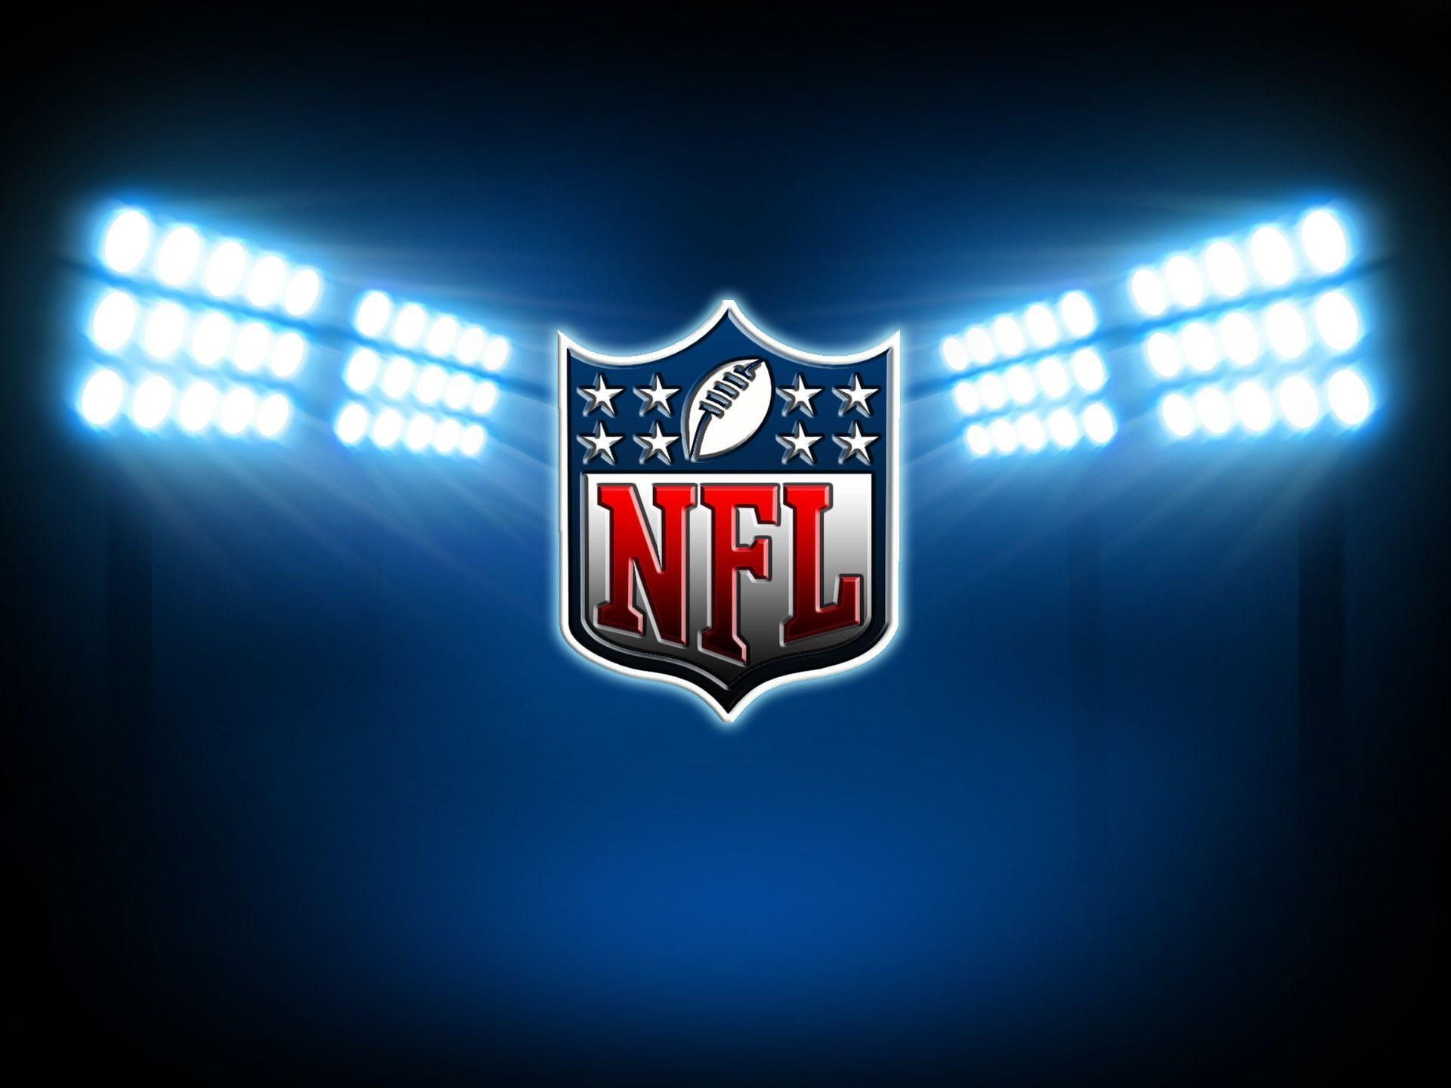
Prediction Dashboard
Andrew Corona
Steve Vo
Luis Espinoza
Sina Sharifi
Alvin Kim

Slide 2

Background
Looking for a more accurate way of predicting the outcome of NFL games by using machine learning
Found data on 2016 – 2018 NFL seasons with 242 data points (features) for every game – total of 371712 data points
Decided on making outcome or y value the offensive score of the team under analysis. In other words, trying to predict the score of the team based on anticipated feature production in next matchup
Hoping to produce results with relative accuracy given modeling challenges

Slide 3
The Process
Acquiring and cleaning the data
Challenges with identifying appropriate/desired datasets. Season data, player data, team game data, etc
Huge need for feature reduction – 242 features initially. Ranging from seemingly more relevant (QB Rating, Turnover Differential, Yards per Play) to seemingly less relevant (Blocked Extra Points, Day of the Week, Humidity, etc)
Assistance identifying signal in the noise (relevant features) by using Random Forest Importance
Initial rf.scores had very low accuracy
Plot out visualizations
Forecast with model and anticipated feature performance
Make assumptions for features. Plug into model. Analyze results

Slide 4
Challenges
Very low rf.score
Questions about ability to predict future features
Just because a team averages 30 points a game (based on past performance), doesn’t mean they’d do so under different circumstances
Very challenging identifying appropriate features. Need to balance predictive but unstable features with stable features that have low correlation to outcome
Time constraints. Homework is dumb
Alcohol dependence taking away from work time

Slide 5
Potential Improvements
Incorporate additional features not included in the dataset
Other available data with more stability and situational relevance would likely improve model. Examples: power ratings, vegas odds/totals, proprietary stats such as DVOA
Downside: would require some web scraping
Identify feature volatility and weight accordingly
How confidently can pertinent features be predicted in the future?
If not very well such as “Fumbles” or other features with a high luck factor, they should be discounted accordingly
We could sharpen up feature predictability by using machine learning to solve for relevant features (make them the Y) and using only data we positively know beforehand
Game conditions: weather, location, etc
Matchup info: vegas line, power rating, key injuries
Rerun model on a team-by-team basis
Use different models to see if we can get a better algorithm: logistic regression, neural networks, deep learning, etc.

Slide 6
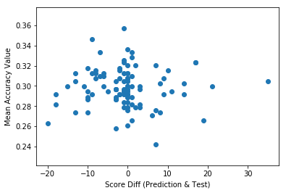
Results
The mean RF accuracy is garbage but the model seems to have a relatively good chance of getting the score right – or close to right.
The caveat to the relatively close score predictions is that we now have the challenge of accurately predicting the features

Slide 7
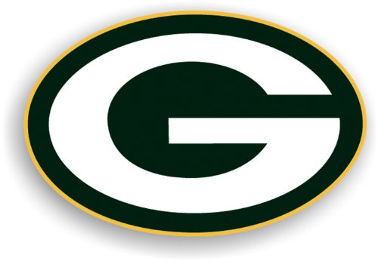

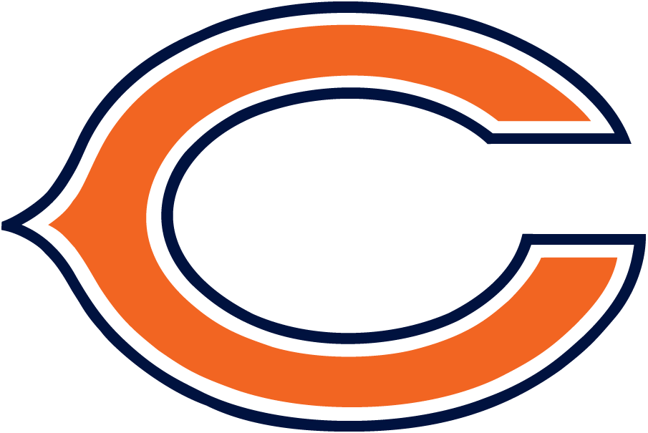
The Predictions
9/5/19 – GB Packers @ Chicago Bears
Green Bay – 27
Da Bears - 24
The Chicago Bears are favored by 3.5 and the O/U is 46 so the bet
would be to take Green Bay and the over (total points 51)

Slide 8
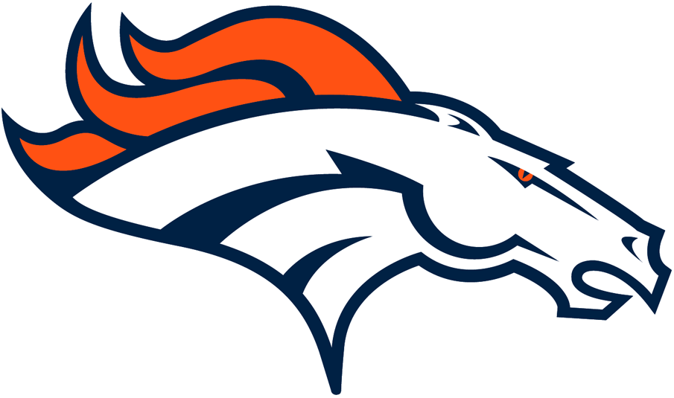

The Predictions
9/9/19 – Denver Broncos @ Oakland Raiders
Denver – 27
Oakland – 20
The Oakland Raiders are favored by 1.5 and the O/U is 43.5 so the bet
would be to take the Denver Broncos and the over (total points 47)

Slide 9
Technologies Used
Python Pandas
Matplotlib
NumPy
Randomforest
Train Test Split

Slide 10

IT’S GAME TIME!

